Slide 1

Capstone Project Hotel Booking Analysis

Slide 2

Valuable Insights: The Power BI dashboard using the Hotels' Database provides valuable insights into the hotels' performance and operations. It presents data-driven analytics on hotel types, popular meals, and Room options. Hotel owners can gain a deeper understanding of customer preferences, bestselling rooms, and effective marketing strategies.
Improvement Focus: The dashboard helps the hotels focus on areas that require improvement. By analyzing holiday trends, countries, and ADR, the dashboard identifies opportunities to optimize sales and increase revenue. It enables the hotel to refine its efficiency and distribution strategies to better cater to customer demands.
Evaluation of Effectiveness: The dashboard facilitates the evaluation of various aspects of the hotel business. It assesses the effectiveness of discounts on reservations, the impact of different types of hotel & room, and the success satisfied customers. With this evaluation, the hotel can make data-driven decisions to enhance its overall effectiveness and have more customers.
Trend Identification: Using historical booking data and guest details, the dashboard identifies the customers' arrival over time. It helps identify seasonal patterns, bestselling rooms and meals in specific periods. This trend identification empowers the hotels to plan for future developments and attract customers more .
Comprehensive Understanding: The Power BI dashboard offers a comprehensive understanding of the hotels' operations. By presenting data on rooms occupied, meal & stay, and special requests required, hotel owners can have a holistic view of the business. This comprehensive understanding enables better decision-making and a more cohesive strategy across all aspects of the Hotel business.

Slide 3




Objective : The objective of this project is to create a comprehensive Power BI dashboard utilizing the Sample Hotel booking Database. The dashboard aims to provide valuable insights into the hotels’ performance and improvements and staff behavior and additional requests which enables data-driven and decision-making and strategic planning.
Analysis Scope : The analysis will focus on various aspects of the publication process, including room bookings, hotel types, countries and impact of vacations. It will encompass historical booking data, market customers based on market segment and distribution channels from different agents.
Goal : The primary goal of this Power BI dashboard is to offer a holistic view of the hotels’ operations. It will provide actionable insights to optimize revenue, improve management , strategies and identify opportunities for growth and efficiency

Slide 4



Insights & Recommendations : The Power BI dashboard will generate valuable insights
into the best hotels , additional requests and sales trend over time. It will analyze the performance of the hotel type, meal & stay options, special requests and calculate regular customers based on repeated customers. Additionally, it will recommend effective discount strategies to boost hotel and customer engagement.
Report & Presentation : The final deliverable will consist of a detailed report describing the data sources, data modelling methodologies, and data cleansing processes used in creating the Power BI dashboard. The report will also include a step-by-step guide on how to interpret the insights and the use the dashboard for decision-making. The presentation will showcase the key findings, visualizations, and actionable recommendations derived from the dashboard’s analysis.
The Power BI dashboard, along with the report and presentation , will serve as a powerful tool for the promoting the hotel for more customers. It will empower them to make informed decisions, optimize meal plan strategies and enhance the overall business performance in the competitive

Slide 5
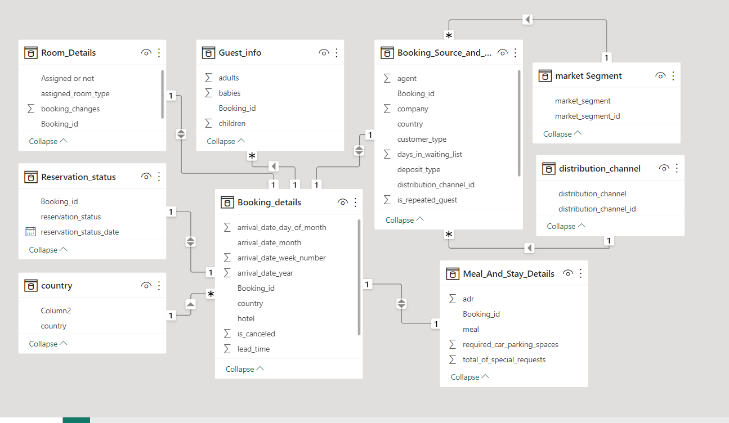
ER Diagram

Slide 6

Data Dictionary
Room_Details
Reservation_Status
The Room_Details table provides information related to room reservations and changes made to them. It is associated with the Booking_Details table via the booking identifier. This table includes details about the type of room initially reserved, the type of room eventually assigned, and the number of changes made to the booking. It offers insights into room allocation dynamics and booking modifications.
The Reservation_Status table records the status of reservations over time. It is connected to the Booking_Details table through the booking identifier. This table captures the reservation's last status (e.g., Canceled, Check-Out) and the date on which this status was recorded. It is valuable for tracking the progression of reservations and understanding their final outcomes.

Slide 7
Guest_Info
Booking_Details
The Guest_Info table provides insights into the guests associated with each booking. It is linked to the Booking_Details table via the booking identifier. This table records the number of adults, children, and babies accompanying the booking, offering an understanding of the composition of guests for each reservation.
The Booking_Details table contains essential details related to hotel reservations. It includes a unique booking identifier and information about the type of hotel (Resort Hotel or City Hotel). Additionally, it records the booking's cancellation status (0 for not canceled, 1 for canceled), lead time (number of days between booking and arrival), year, month, week number, and day of the month of arrival. The table also captures the number of weekend and weekday nights stayed.

Slide 8
Meal & Stay
Booking_Source_& _History
The Meal_And_Stay_Details table complements the booking information by specifying meal-related and stay-related attributes. It connects to the Booking_Details table via the booking identifier. This table includes the type of meal booked (e.g., Bed & Breakfast, Half Board), the Average Daily Rate (ADR) for the stay, the number of required car parking spaces, and the total count of special requests made by the guest.
The Booking_Source_and_History table is crucial for understanding the source of bookings and the historical behavior of guests. It is connected to the Booking_Details table via the booking identifier. This table encompasses information such as the market segment (e.g., Online Travel Agents, Direct Booking), distribution channel (e.g., Online Travel Agents, Direct Booking), and whether the guest is a repeated visitor (0 for not repeated, 1 for repeated). Additionally, it records the number of previous booking cancellations, previous bookings that were not canceled, the deposit type (e.g., No Deposit, Non-Refund), the booking agent's ID, the company's ID, the number of days a booking spent on the waiting list, and the customer type (e.g., Transient, Group).

Slide 9

Power BI Problem Statement

Slide 10
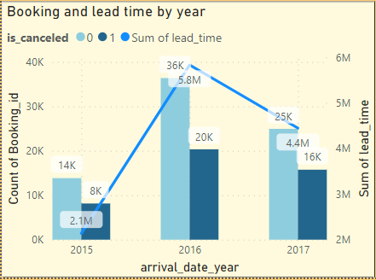
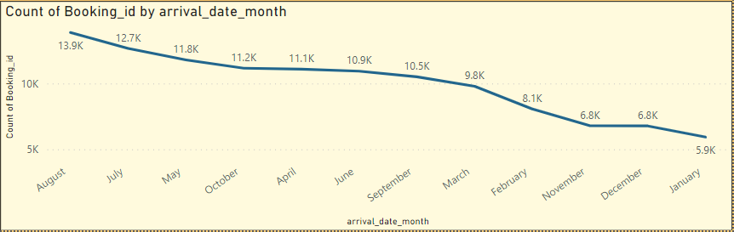
Visualize booking trends over the years, including the number of bookings, cancellations, and average lead time. Identify seasonality patterns.
The year 2016 was a peak year for the hotels , in which they have around 36370 customers have been booked
20337 customers has been cancelled, at the year 2017 the hotels have 24942 customers have been booked and 15745 customers have been cancelled. The year 2015 have 13854 customers have been booked and 8142 customers have been cancelled. For the Average lead time for 2015 is around 2.1M , 2016 is around 5.8M , 2017 is around 4.4M.
2.Analyze monthly booking patterns to identify peak months and optimize marketing strategies.
The peak month with most number of sales or booked dates is the August and July , the reason why these months are being booked a lot is because it is a summer vacation in Europe, where most were from Europe, especially Portugal.

Slide 11
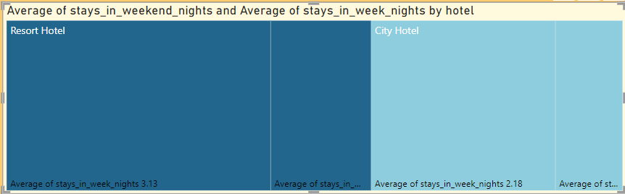
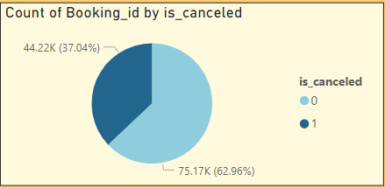
3.Compare stays in weekend nights and weekday nights to determine preferences and variations by hotel type.
The most average of stays in weekend nights and weekday nights are the Resort hotel has stayed for 3.13 days during the weekdays. And the least average is the City Hotel has stayed for 0.80 days during the weekends.
4. Calculate and visualize the booking conversion rate (canceled bookings to total bookings) over time.
As per in the pie chart, the percentage of being cancelled is around 37.04% of the whole booking so the chance of the booking getting cancelled is 37.04% .

Slide 12
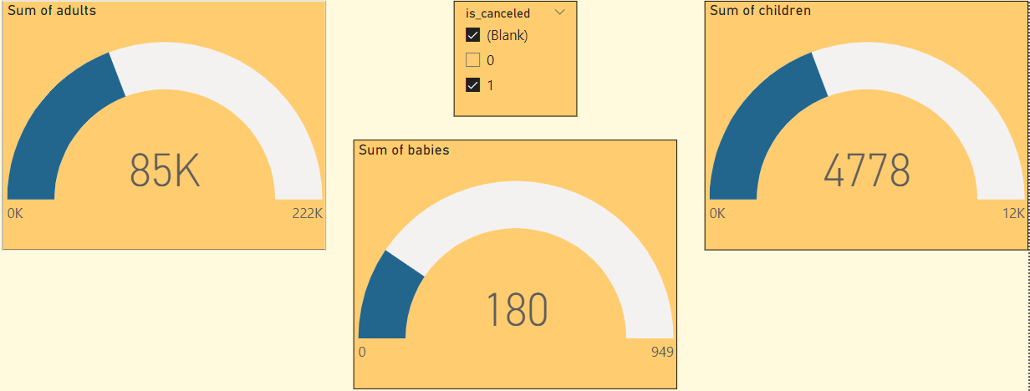
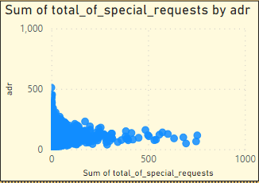
5. Visualize the distribution of adults, children, and babies in bookings. Explore the impact of children and babies on cancellation rates.
The Sum of adults are 222K adults in Overall, the Sum of children are 12K kids in Overall and the Sum of babies are 949 babies in Overall.
The Checked Out adults are 138K , the Checked Out children are 7720 kid and the Checked Out babies are around 780.
6. Analyze the distribution of Average Daily Rates (ADR) and identify correlations with the number of special requests made by guests
The sum of the total special requests distributed by ADR, the most highest ADR is for the customer with no special requests are 510 , so the highest number of special requests are 754 with the ADR 115.

Slide 13
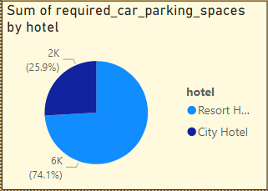
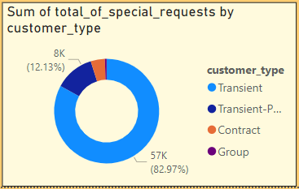
7. Visualize the relationship between the number of required car parking spaces and booking types (Resort Hotel vs. City Hotel).
The car parking spaces is required from both the hotels , but the Resort hotel has a over 6K requests and the city hotel has 2K requests. So the resort hotel has a lot of nearby customers to the hotel compared to the city hotel.
8. Use Power BI to explore how the total number of special requests made by guests varies by hotel type and customer type (e.g., Transient, Group).
The Transient type customers are the majority of the other types with over 82.97% and the Transient-Party are 12.13%

Slide 14
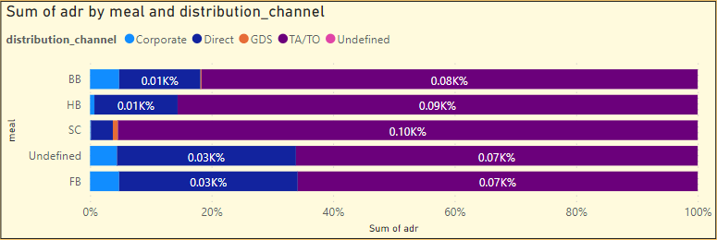
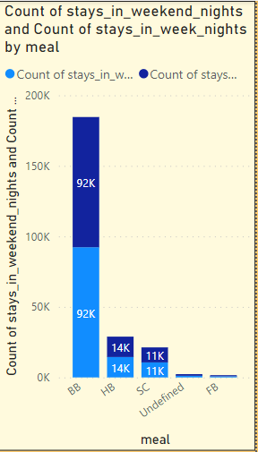
9. Explore meal plans and their impact on Average Daily Rates (ADR). Analyze meal plan preferences and their association with booking channels.
The TA/TO channel has the maximum sum of ADR for all the types of meal & stay options. And the Direct channel has some ADR in BB, Undefined and FB.
10. Analyze how meal plans correlate with stay duration and investigate
any differences in stay lengths based on meal plans.
The BB type of Meal & Stay has the most customers who stays in weekend and weekdays around 92K for both weekend and weekdays. And the HB and SC have customers 14K and 11K simultaneously.

Slide 15
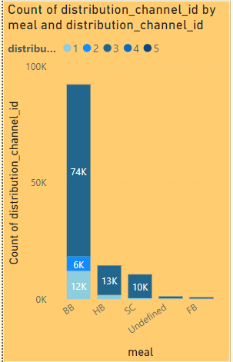
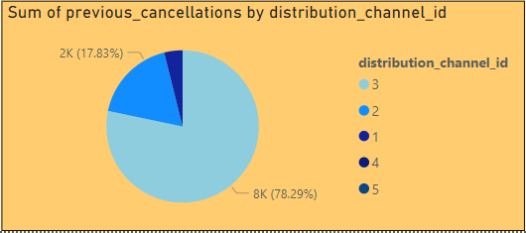
11. Explore how meal plans are distributed across various booking channels. Analyze if certain channels are associated with specific meal plans.
The most common channel are being used from all the types meal & stay used customers which is the 3rd channel which around 74K for BB meal & stay. The 1st channel also being used for 12K customer in BB meal & stay.
12. Visualize booking distribution across different market segments and analyze cancellation rates within each segment.
The majority is the 3rd channel with around 78.29% and 2nd has 17.83%, The 1st channel has a percent of 4.04%.

Slide 16
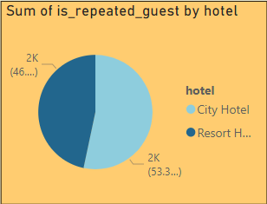
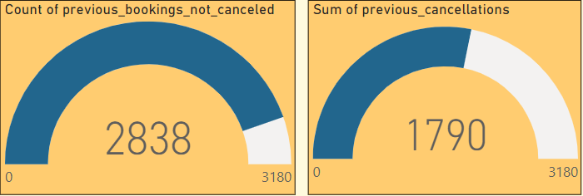
14. Visualize the percentage of repeated guests for each hotel type (Resort Hotel vs. City Hotel) over time. Explore factors influencing guest retention.
There is a slight edge in comparison for both the types of hotels , the city hotel and the resort hotel has 2032 and 1772 repeated customers.
15.Visualize the percentage of repeated guests for each hotel type (Resort Hotel vs. City Hotel) over time. Explore factors influencing guest retention.
The People who did not cancel their booking are 2838 out of 3180 guests. And then there are customers who are being cancelled , which are 1790.

Slide 17
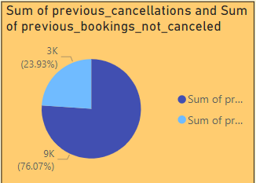
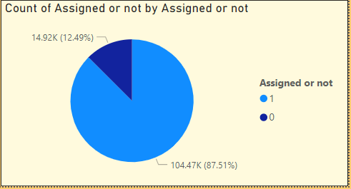
16. Analyze the impact of a guest's booking history (previous cancellations and non-canceled bookings) on their likelihood of canceling a current booking.
As given in the pie chart the repeated customers would most likely will not cancel around 76 % meanwhile the cancellation is around 23.93 %.
17. Visualize the distribution of reserved and assigned room types. Analyze whether guests tend to receive the room type they initially reserved
The customers who reserved / requested their specific room type and got their room preferred for 87.51% of the customers, whereas the remaining 12.49% of the customers haven’t got their preferred room

Slide 18
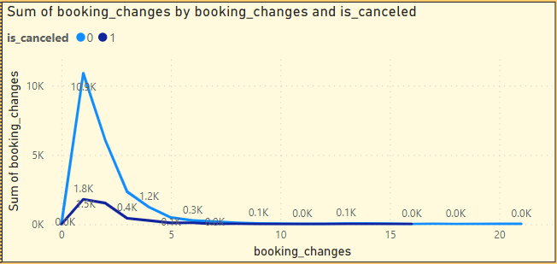
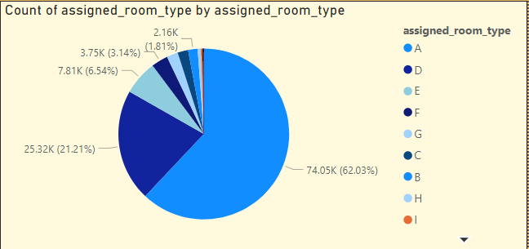
18. Investigate the relationship between the number of booking changes made by guests and their likelihood of canceling a booking.
The most customers who made booking changes are the customers who did not cancel and made only 1 change.
19. Analyze room type preferences based on customer types (e.g., Transient, Group) and identify any patterns in room type selection.
The most demanded room type is the A type room in which 62.03% of the customers and D type room is in 2nd with around 21.21% of the whole lot.

Slide 19
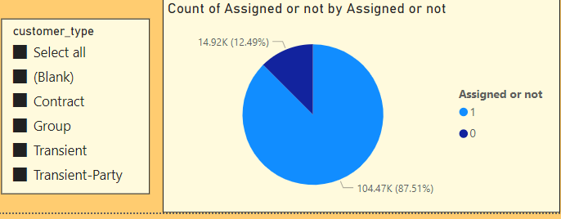
20. Analyze whether guests who make multiple bookings tend to consistently request the same room type or if their preferences change over time.
The most customers who made booking changes are the customers who did not cancel and made only 1 change.
19. Analyze room type preferences based on customer types (e.g., Transient, Group) and identify any patterns in room type selection.
The most assigned people are from the Transient type of customer which overall is at 87% for Assigned and 12.49% for Not Assigned.

Slide 20
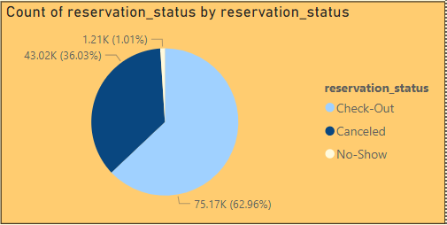
20. Analyze whether guests who make multiple bookings tend to consistently request the same room type or if their preferences change over time.
The most customers who made booking changes are the customers who did not cancel and made only 1 change.
21. Provide an overview of reservation statuses over time, including the percentage of canceled, checked-out, and no-show bookings.
In the Pie chart, there are 62.96% of Check-Out customers , 36.03% of Cancelled customers and 1.01% of No-Show customers.

Slide 21
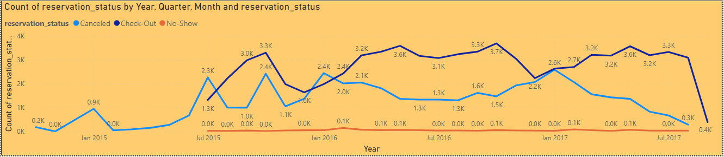
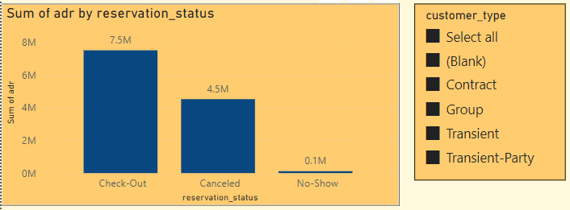
22. Analyze trends in reservation status dates, such as the busiest checkout dates or patterns in cancellations by month.
23. Visualize how reservation statuses vary across different customer types (e.g., Transient, Group) and identify if certain customer types are more likely to result in cancellations or no-shows.
The most ADR from the reservation status and the most type of customers are the Transient customers whose being Checked Out.

Slide 22

EDA Problem Statement

Slide 23
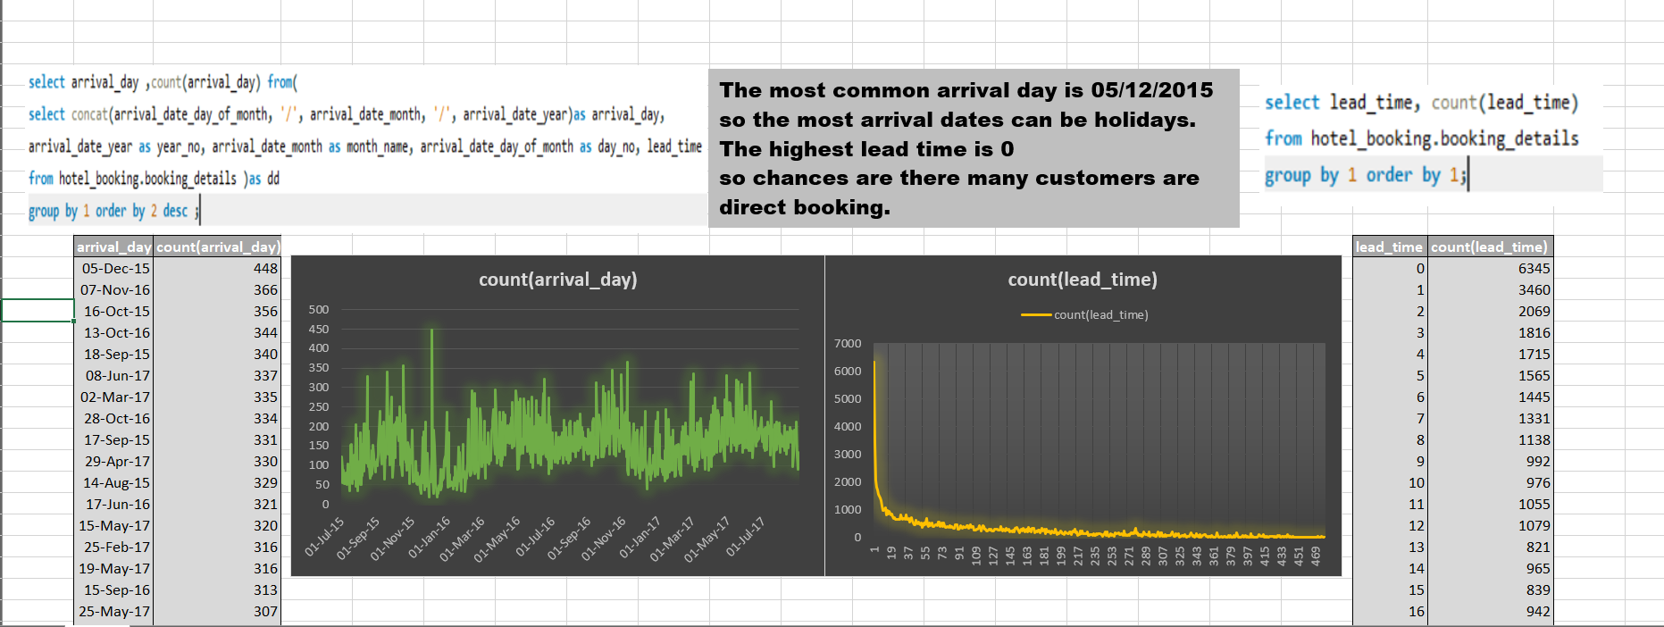
Understand the distribution of arrival dates, including the most common arrival days and summary statistics for lead times

Slide 24
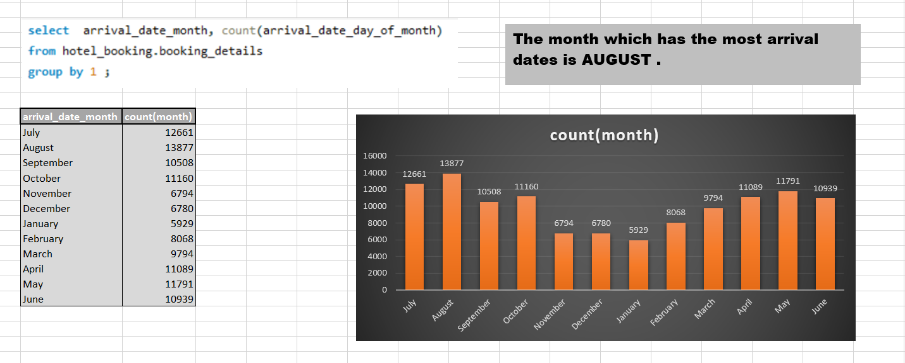
Identify peak booking months and analyze reasons for spikes in bookings, including holidays or events.

Slide 25
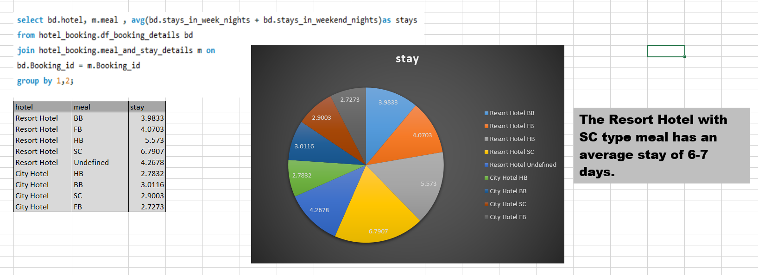
Calculate the average length of stays for different hotel types and explore variations by meal plans

Slide 26
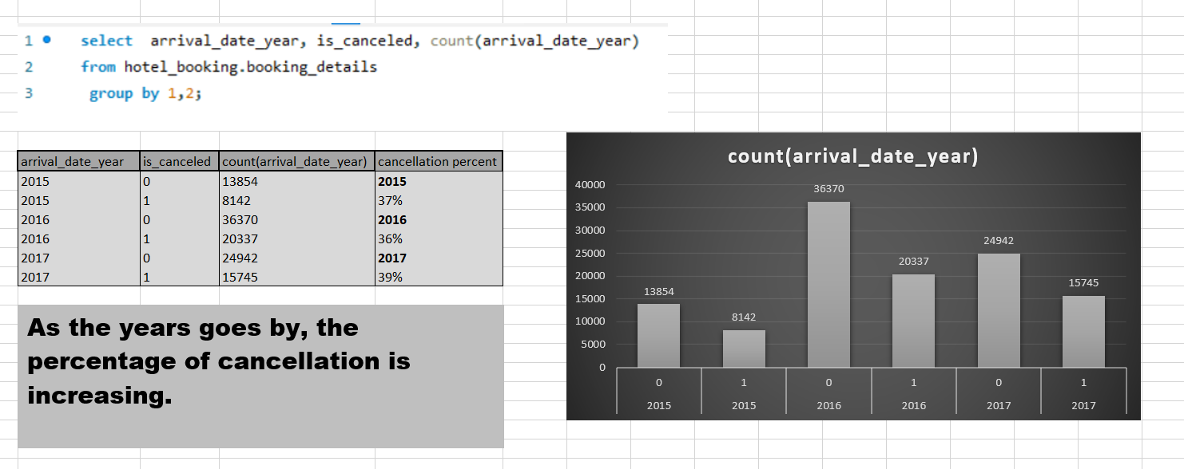
Analyze how booking patterns have evolved over the years, including year over year changes in bookings and cancellations.

Slide 27
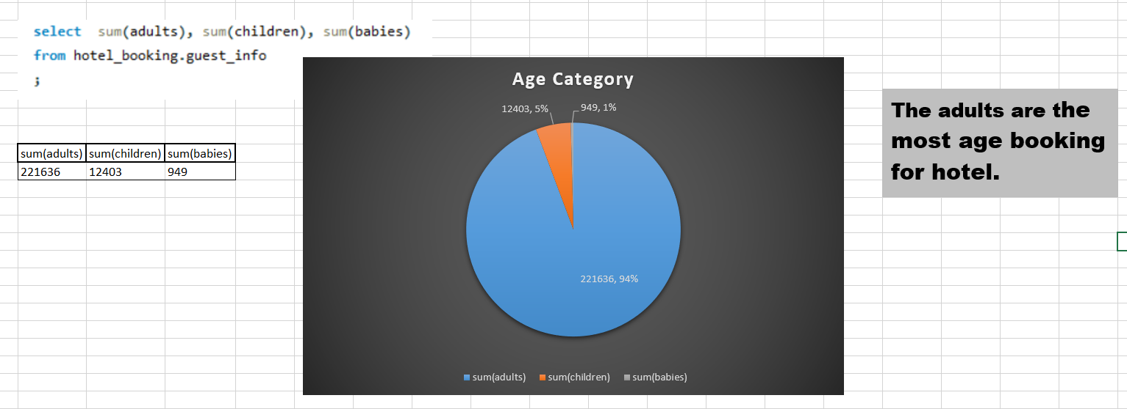
Understand the distribution of the number of adults, children, and babies and identify any outliers.

Slide 28
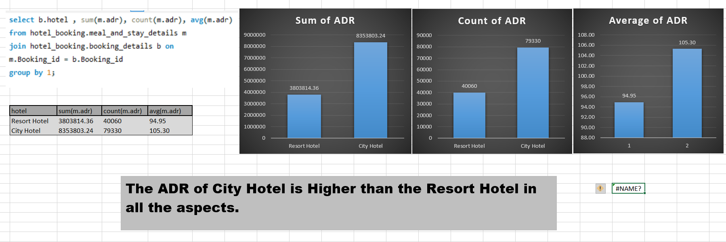
Calculate summary statistics for ADR and explore differences between Resort Hotel and City Hotel bookings

Slide 29
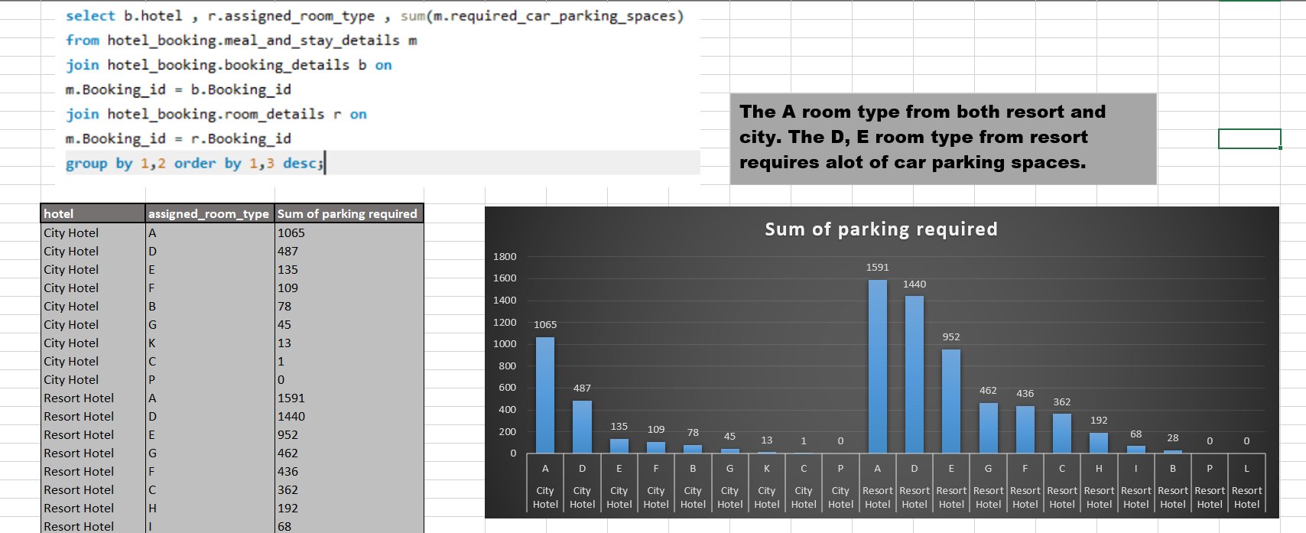
Analyze the distribution of required car parking spaces for each hotel type and determine if one type attracts more guests with cars

Slide 30
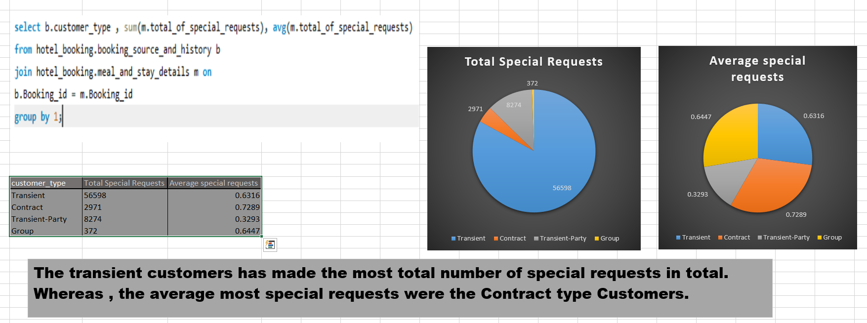
Compare the total number of special requests made by different customer types (e.g., Transient, Group) and identify which customer type makes more requests

Slide 31
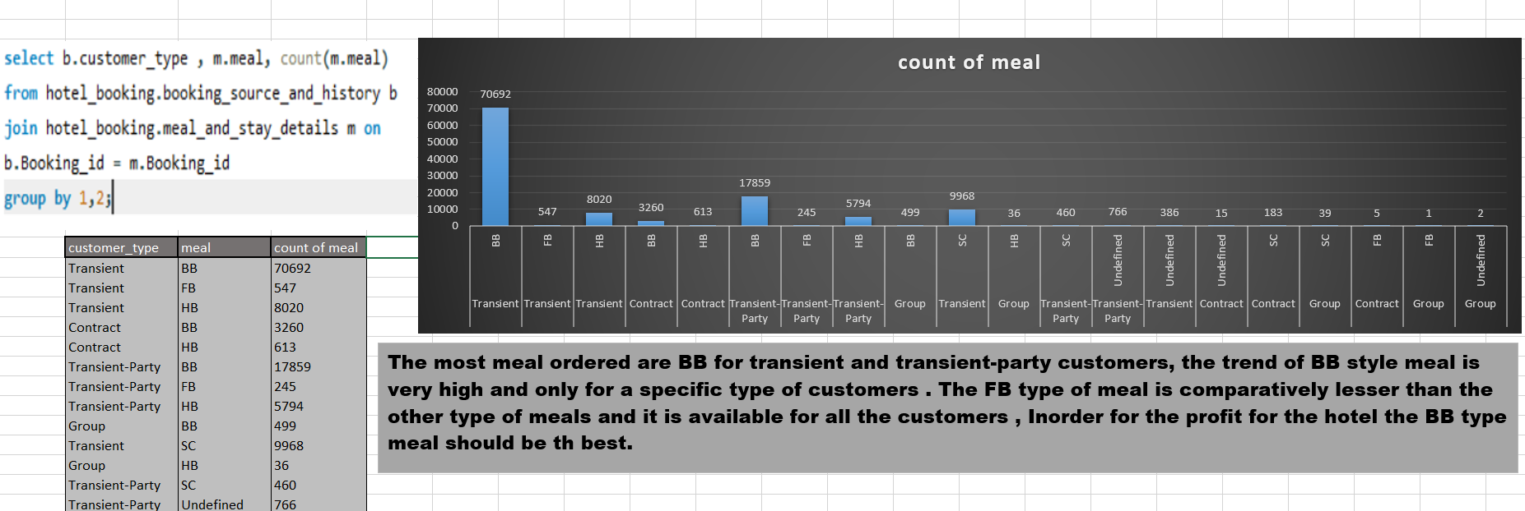
Understand the distribution of meal plans (e.g., BB, HB, FB, SC) and identify any patterns or preferences

Slide 32
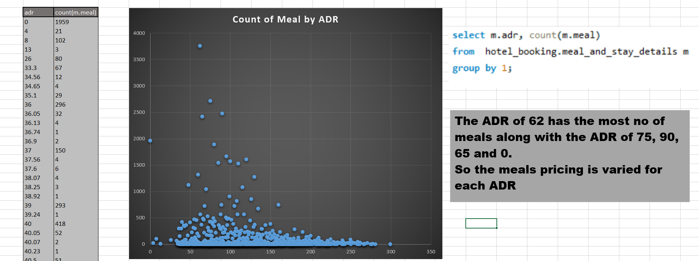
Analyze Average Daily Rates (ADR) by meal plan type to identify variations in pricing

Slide 33
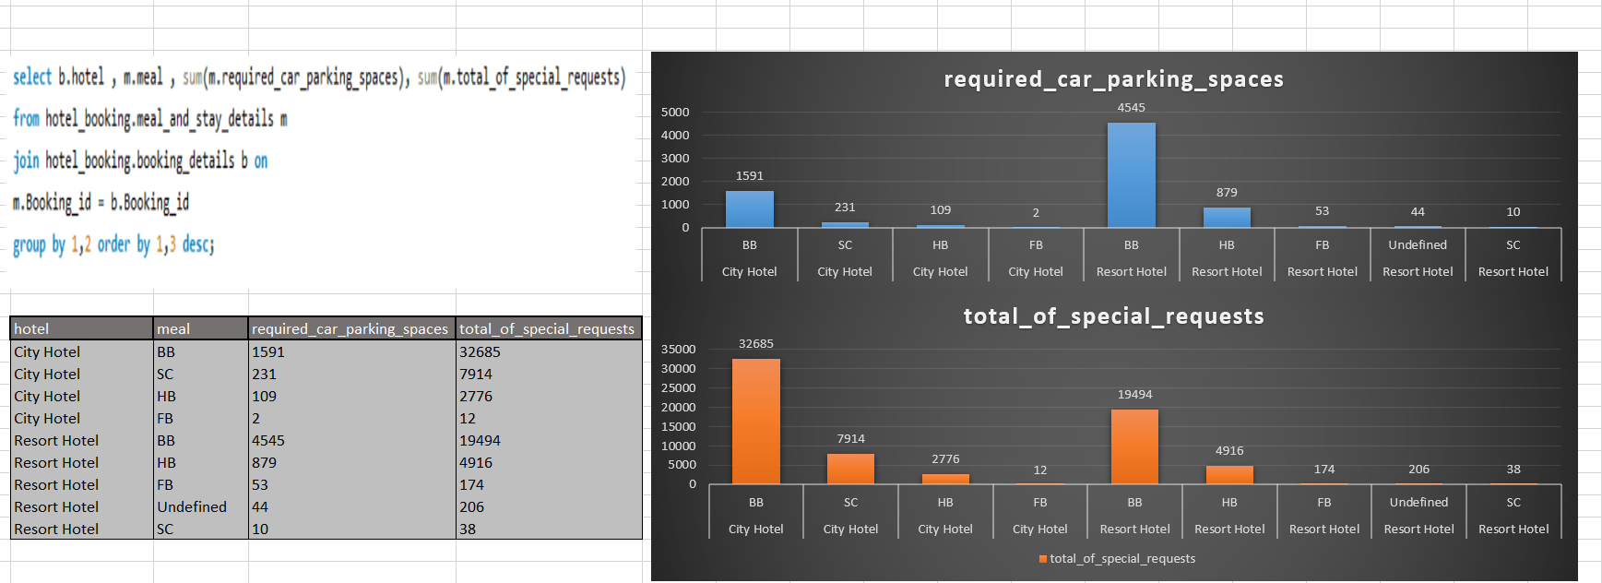
Investigate the distribution of required car parking spaces and special requests by hotel type and meal plan. 12 .Compare the distribution of meal plans among different customer types (e.g., Transient, Group) to identify preferences

Slide 34
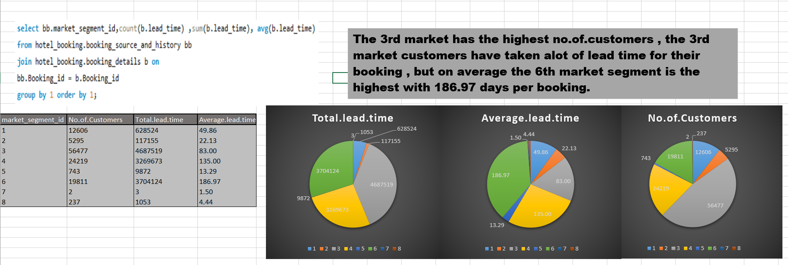
Understand the distribution of bookings across different market segments and calculate summary statistics for lead times within each segment

Slide 35
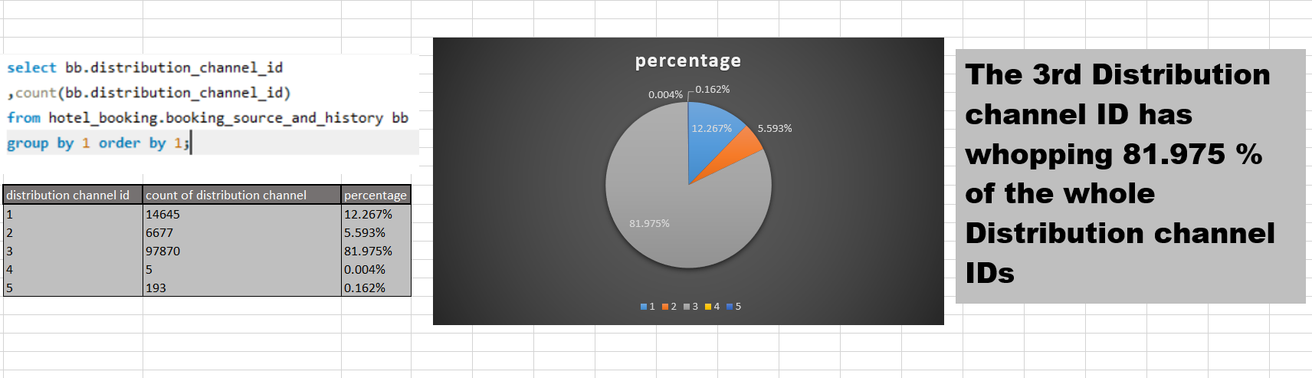
Analyze the distribution of bookings through different booking channels (e.g., online travel agents, direct bookings) and calculate the percentage of bookings through each channel

Slide 36
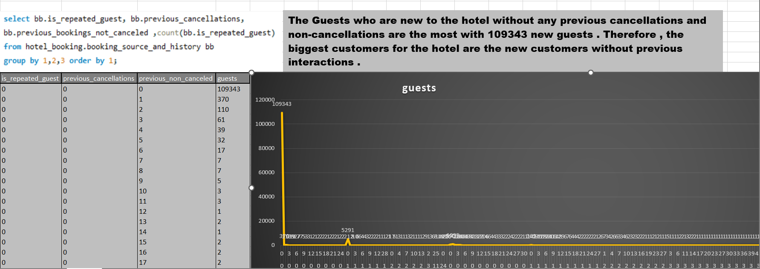
Calculate the proportion of repeated guests and investigate their booking behavior. Identify any patterns or differences in preferences compared to first time guests

Slide 37
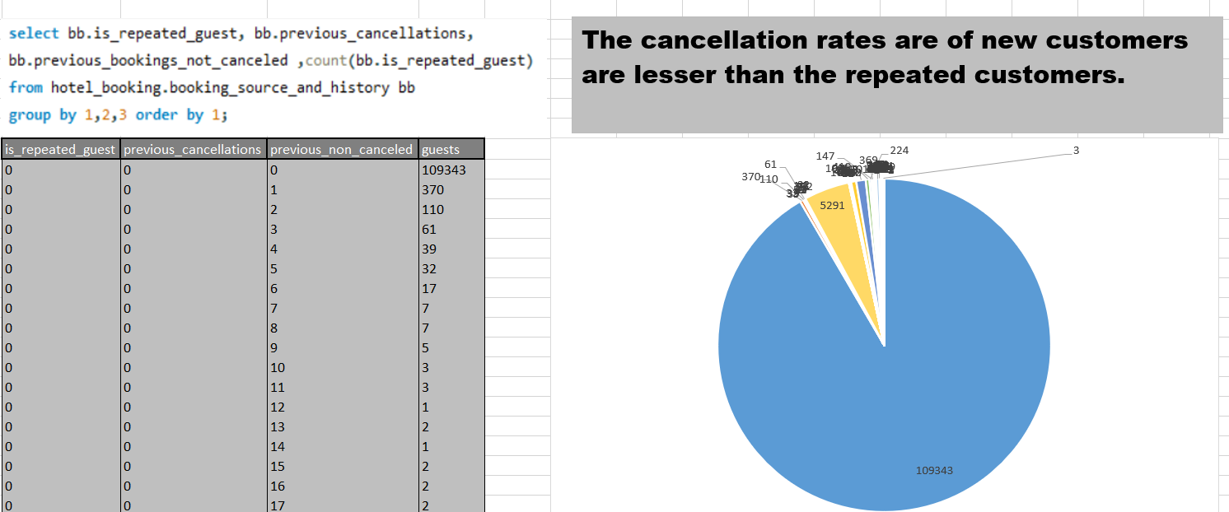
Explore the impact of a guest's booking history on their likelihood of canceling a current booking. Calculate cancellation rates based on previous cancellations and non-canceled bookings

Slide 38
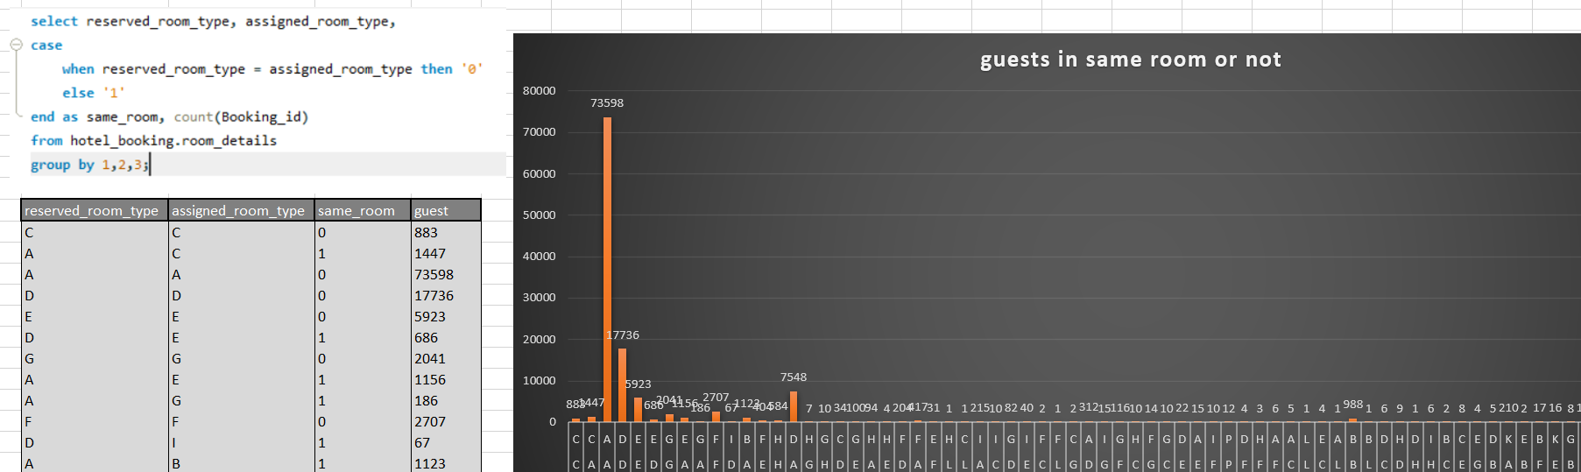
Understand the distribution of reserved and assigned room types. Calculate summary statistics for the consistency between reserved and assigned room types

Slide 39
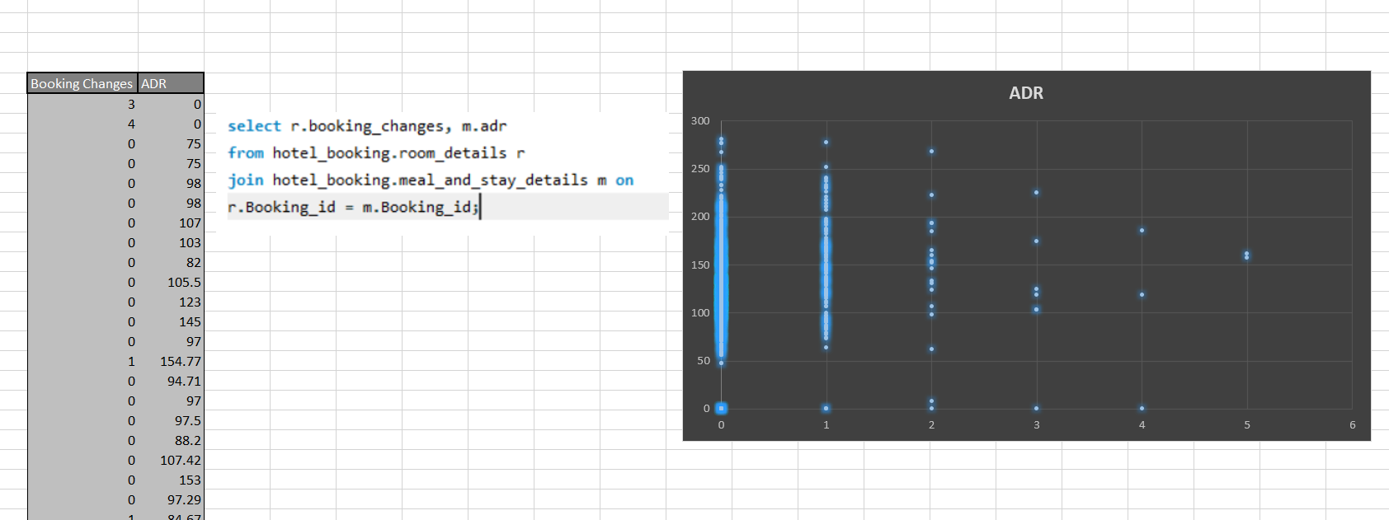
Analyze the impact of booking changes on cancellation rates. Calculate cancellation rates for bookings with different numbers of changes

Slide 40
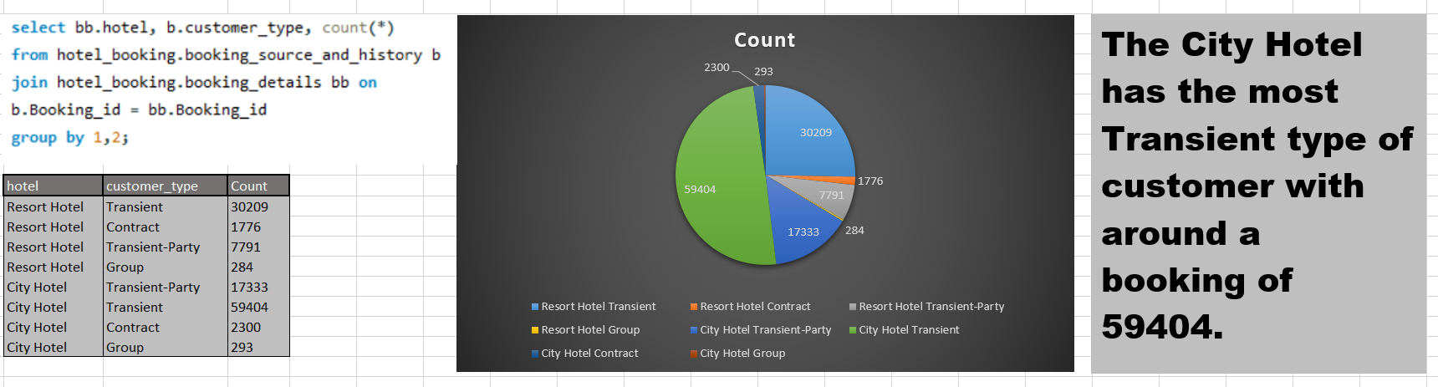
Explore how room type preferences vary across different customer types (e.g., Transient, Group). Identify if certain customer types have specific room preferences

Slide 41
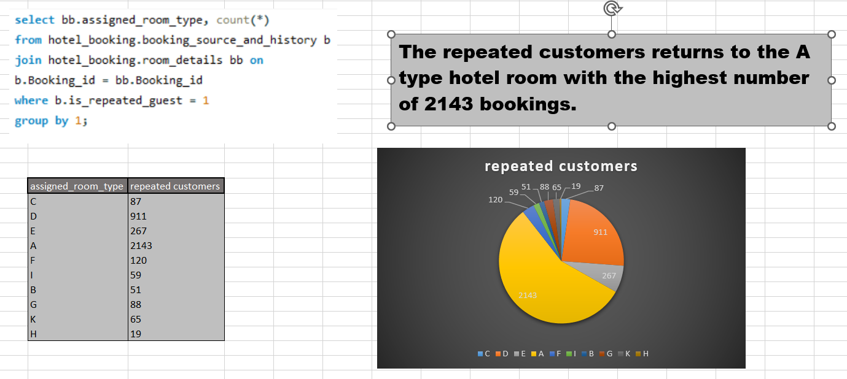
Examine whether guests who make multiple bookings have consistent room type preferences or if their preferences change over time

Slide 42
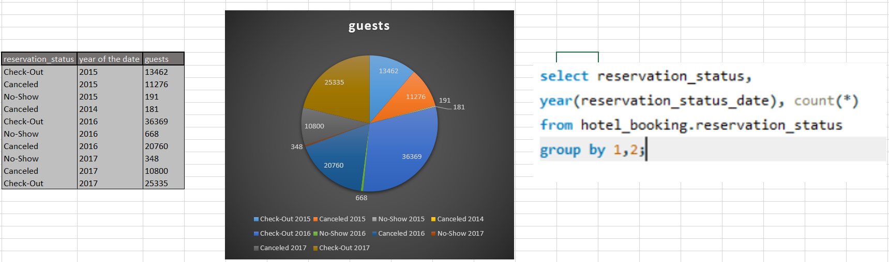
Understand the distribution of reservation statuses and calculate summary statistics for reservation status dates

Slide 43
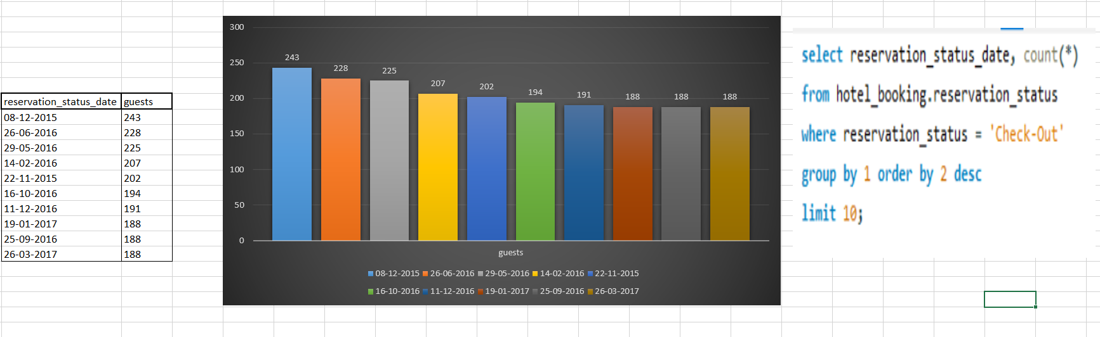
Analyze trends in reservation status dates, including the most common checkout dates and any seasonality patterns

Slide 44
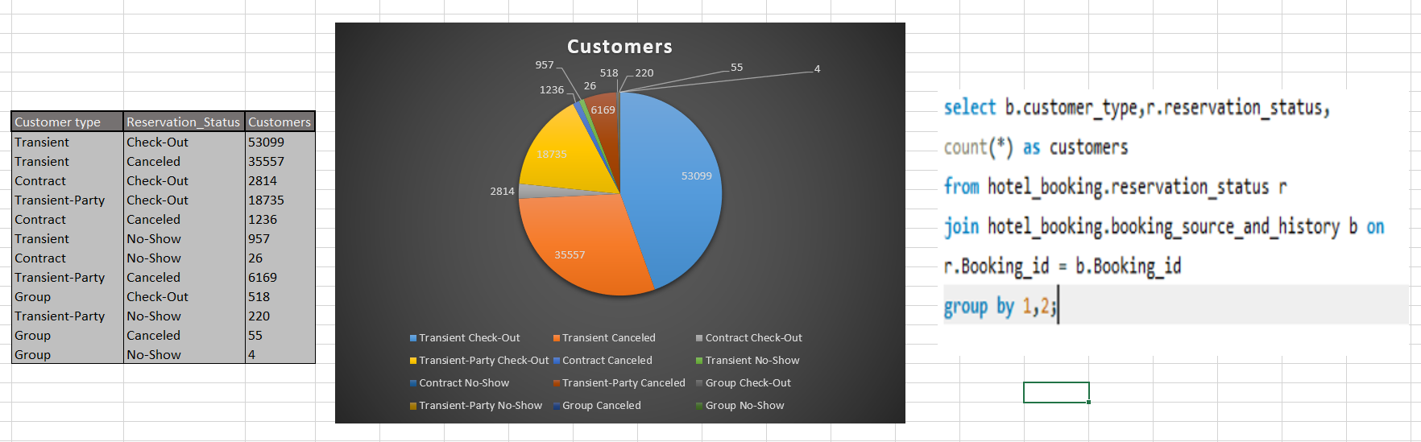
Explore how reservation statuses vary across different customer types (e.g., Transient, Group) using Excel or SQL. Calculate cancellation rates by customer type

Slide 45
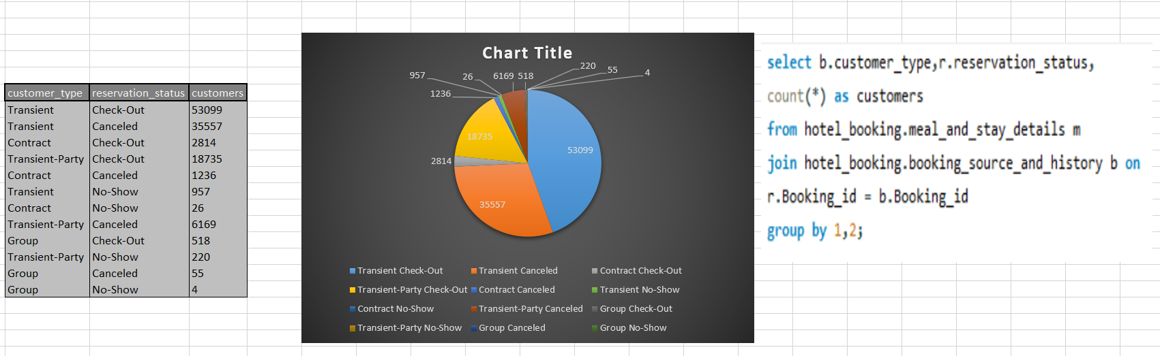
Investigate whether there are differences in Average Daily Rates (ADR) based on reservation status (e.g., canceled vs. checked out)

Slide 46

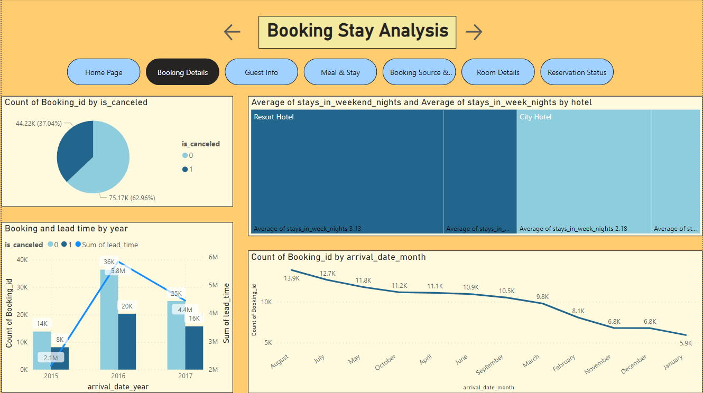

Slide 47
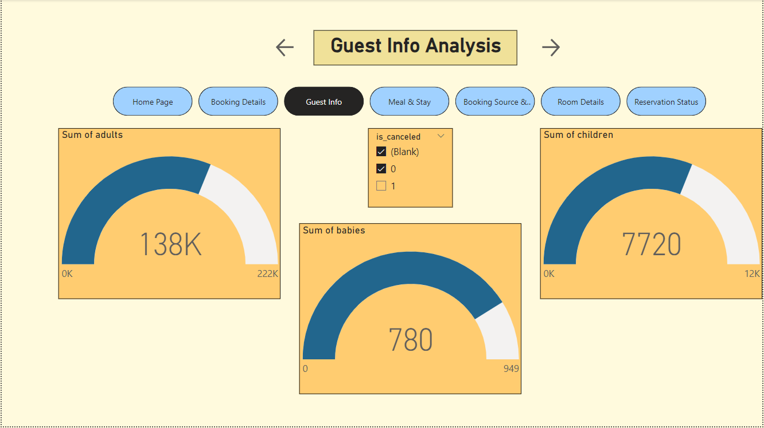

Slide 48
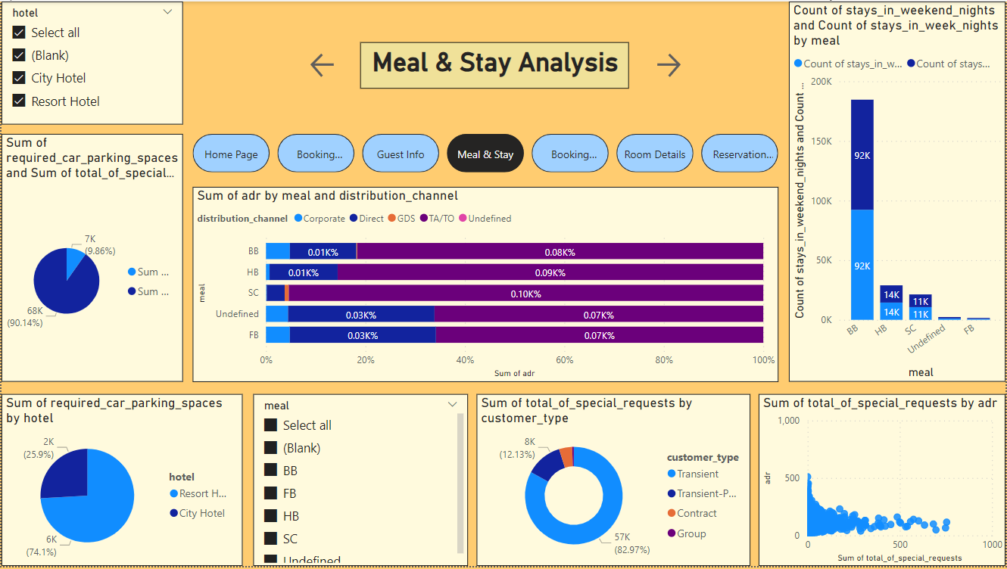

Slide 49
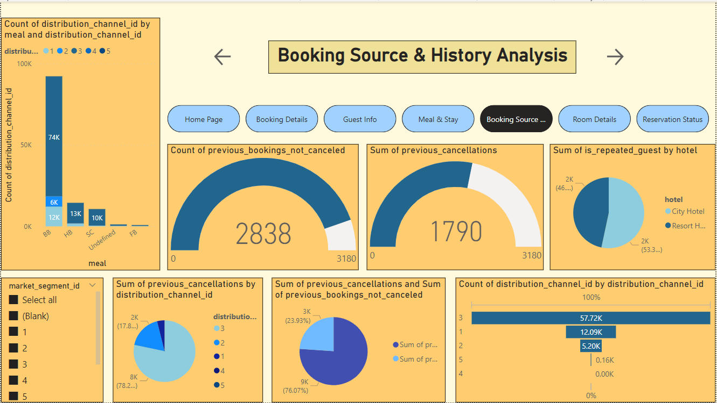

Slide 50


Slide 51


Slide 52
Conclusion
In conclusion, the hotel booking analysis project has provided valuable insights into the patterns, preferences, and behaviors of our customers. By examining the data, we have been able to identify key trends, such as peak booking seasons, preferred room types, and booking channels. This knowledge is instrumental in making data-driven decisions to optimize our services, increase customer satisfaction and make them feel to return to the hotel. The project has not only enhanced our understanding of our guests but also highlighted the importance of data analytics and technology in the hospitality industry. By using the power of data, we can make informed decisions that benefit both our guests and our business.

